Slide 1
FabCon SQLCon

Slide 2

Semantic Link Labs:
The Data Detective’s Toolkit
Jason Romans

Slide 3
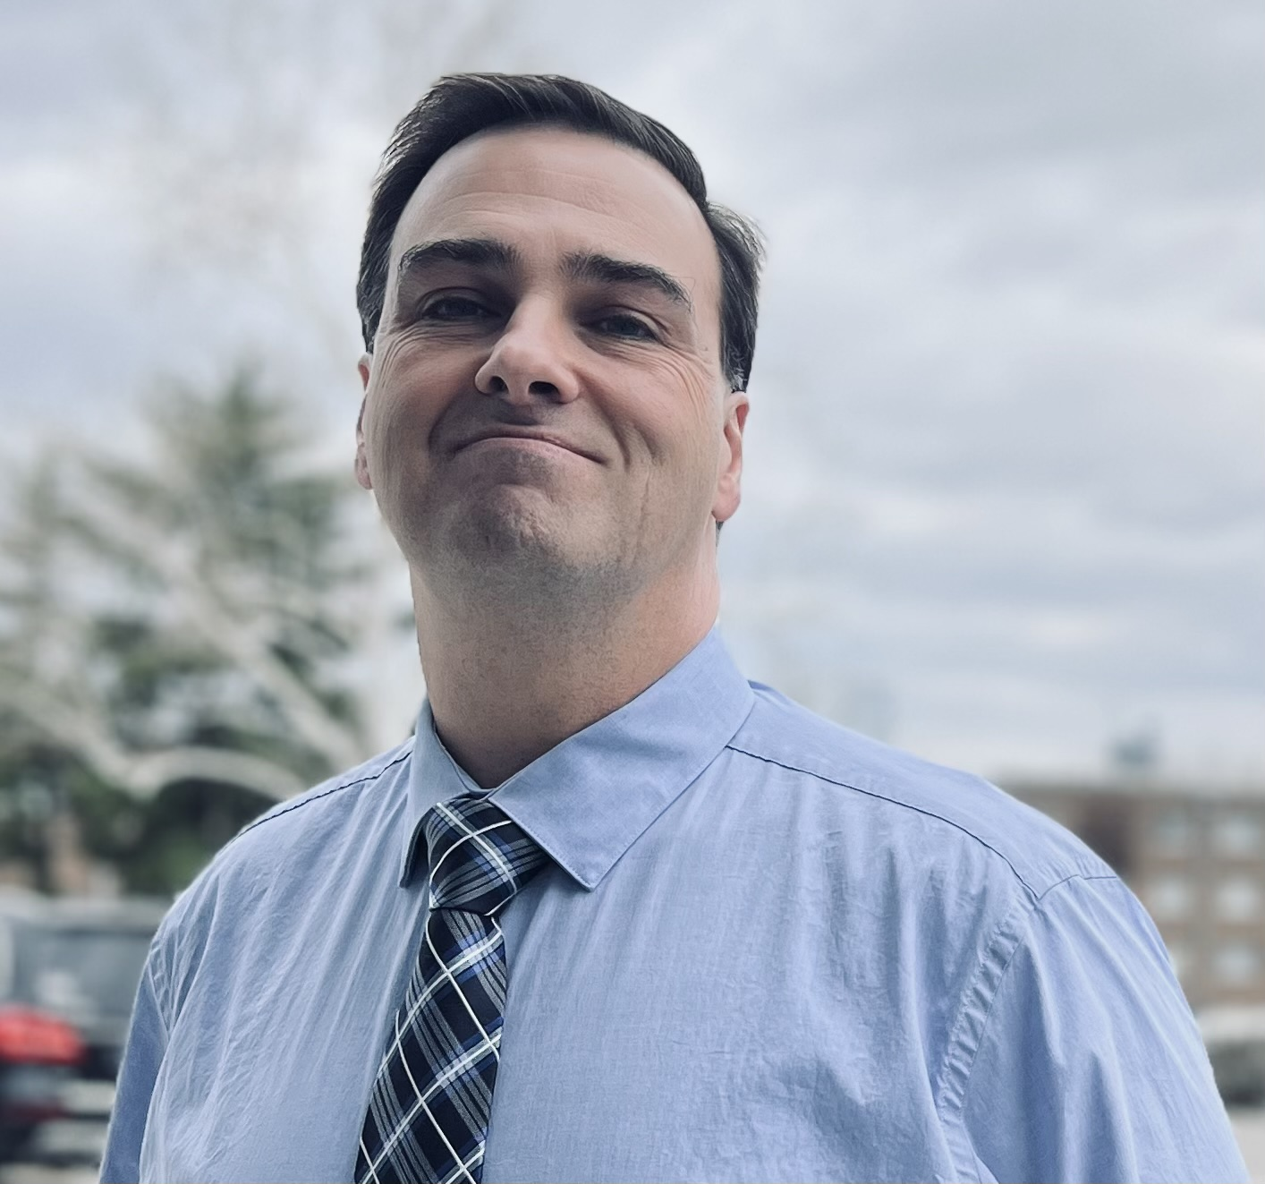


Jason
Romans
Cloud Data & Integration Developer
📍 Nashville, TN, USA
🛠️ Began Career as a SQL Server DBA
➡️ Transitioned to Microsoft BI Stack
📦 Data Engineering to Data Modeling
The DAX Shepherd
@sql_jar
jason-r-sql-jar
https://thedaxshepherd.com/
DataTune Nashville 2026

Slide 4
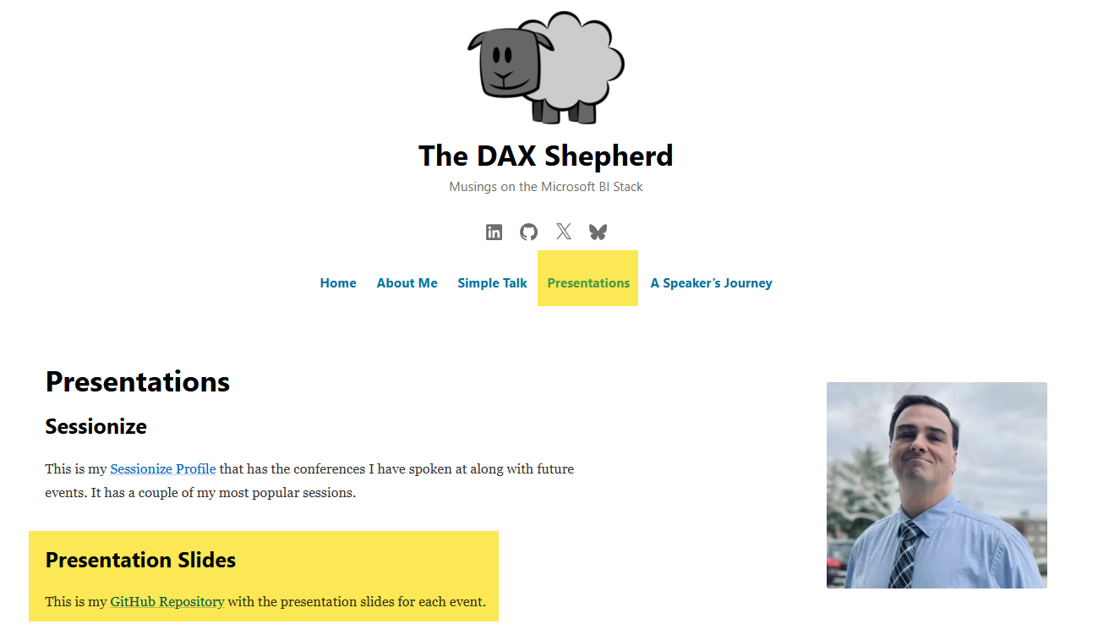
DOWNLOAD THIS PRESENTATION
All slides, resources, and demo files available:
The DAX Shepherd
www.thedaxshepherd.com/presentations
[Screenshot: Blog homepage
showing 'Presentations' navigation]
[QR Code]

Slide 5

Standing on the Shoulders of Giants
This Photo by Unknown Author is licensed under CC BY-ND
Grateful for the people who share their knowledge, encourage us, answer questions, and help the rest of us learn faster.

Slide 6



The Case for Semantic Link Labs
Why this matters and what Semantic Link Labs enables
OPEN THE CASE
CASE DEMOS
DETECTIVE AGENCY
CASE CLOSED
YOU ARE HERE

Slide 7
Sound Familiar?
"It was fine on Friday"
Notes:
"It was fine on Friday."
"that's the Monday morning email subject line we've all gotten — and today we're going to stop reacting to it and start investigating it."

Slide 8

Symptoms aren’t evidence — they’re just the first clue.
Why BI Teams Need Detectives
Too often, BI teams investigate only after something breaks.
Model size creeps up
Best practices drift over time
Small changes leave a wide trail
Performance issues appear before cause

Slide 9
Use the detective habit:
Notice the detail that doesn’t fit
Follow the trail of dependencies
Prove it with evidence
Turn investigation into prevention
Monk Moment: "Something’s off"
That instinct is valuable when paired with evidence.

Slide 10
What You’ll Learn
By the end, you’ll be able to:
Investigate model performance with evidence
Trace dependencies and understand change impact
Detect breakage and hygiene issues proactively
Turn investigations into a reusable playbook

Slide 11
The Detective Method
Use this loop for every mystery you investigate.
Investigation loop:
Symptom (what users feel)
Evidence (what we can prove)
Suspects (ranked likely causes)
Fix (targeted action)
Prevention (make it repeatable)

Slide 12
Detective’s Toolkit
SL
SLL
FN
Semantic Link
Semantic Link Labs
Fabric Notebook
Microsoft first-party library
Runs inside Fabric notebooks
Core: list tables, run DAX, read metadata
Open source
Extends Semantic Link
BPA · VertiPaq · report scanning
The runtime environment
Where detective
work happens
Python + Spark, pre-installed libraries

Slide 13







Semantic Link Labs
Microsoft Fabric
Semantic Link
Semantic Link Labs
List Tables
Recover Deleted Lakehouse Objects
List Workspaces
Best Practice Analyzer
List Models
Migrate to Direct Lake
List Reports
View Broken Reports
Manage Reports
Rebind Reports

Slide 14
Semantic Link + Semantic Link Labs
What this unlocks:
Inspect Fabric through code, not just the UI
Investigate assets and metadata systematically
Trace relationships and understand downstream impact
Catch problems earlier and reduce guesswork
Turn one-off investigations into repeatable practice

Slide 15
Semantic Link
Microsoft’s first-party Fabric Python library
  Runs only inside the Fabric runtime
  Foundation layer: import sempy.fabric as fabric
  Preinstalled in the default runtime
    Update with %pip install -U semantic-link
  Extended by Semantic Link Labs

Slide 16
Semantic Link Labs
  Michael Kovalsky
    aka “Kovalsky’s Laboratory”
  “Expansion Pack” — Kurt Buhler
  Built on Semantic Link
    import sempy.fabric as fabric
  Open source on GitHub
    Active Development

Slide 17
Installing in Microsoft Fabric
Update packages in a notebook cell
Semantic Link
Preinstalled in the Fabric runtime
%pip install -U semantic-link
Semantic Link Labs
Install separately when needed
%pip install –U semantic-link-labs

Slide 18

Follow the Evidence
Real demos that uncover what is happening in Fabric
OPEN THE CASE
CASE DEMOS
DETECTIVE AGENCY
CASE CLOSED
YOU ARE HERE

Slide 19
Case File: The Unidentified Model
Arrive at the scene. Catalog everything before you touch it.
VICTIM: A semantic model in a new Fabric workspace
SYMPTOMS:
• No programmatic inventory — structure is trapped in the UI
• Relationships exist in the model but not in the data — or vice versa

Slide 20
Case File: The Relationship Web
He sees connections others miss. So does find_relationships.
VICTIM: A semantic model with undetected relationship gaps
SYMPTOMS:
• Power BI shows only the relationships it was told about
• Data suggests more connections exist — but nobody modeled them

Slide 21
Case File: Running the Numbers
Your DAX knowledge is trapped in the desktop. Time to set it free.
VICTIM: DAX knowledge locked inside Power BI Desktop
SYMPTOMS:
• Can't query the model programmatically from a pipeline
• DAX results can't feed downstream Python or notebook logic
• No way to automate recurring DAX calculations

Slide 22
DEMO TIME
DEMO: The Detective’s Toolkit (Cases 1–3)
Let’s go investigating...

Slide 23
SOLVED
Case Board: Investigations 1–3
Cases closed. Evidence on record.
CASE 01
The Unidentified
Model
CASE 02
The Relationship
Web
CASE 03
Running the
Numbers
SOLVED
SOLVED

Slide 24
Case File: Something Doesn't Add Up
Every relationship has two sides. Not every key agrees.
VICTIM: Referential integrity violations hiding in your model
SYMPTOMS:
• Fact table keys that point to dimension values that don't exist
• Blank members appearing in slicers or visuals unexpectedly
• Aggregations silently drop rows with no error

Slide 25
VICTIM: A Delta table just written to OneLake
SYMPTOMS:
• Table confirmed written in the notebook
• Not visible in the SQL Analytics Endpoint
Case File: The Evidence Isn’t Ready Yet
The witness statement exists. Monk knows it. But it’s not in the file.

Slide 26
Case File: The Witness Vanished
The witness was there. Then they weren't.
VICTIM: A Delta table deleted from the Lakehouse
SYMPTOMS:
• Table confirmed visible in SQL Analytics Endpoint
• Then gone — query returns nothing
• No backup process, no pipeline to re-run

Slide 27
DEMO TIME
DEMO: The Detective’s Toolkit (Cases 4–6)
Let’s work the case......

Slide 28
Case Board: Investigations 4-6
Cases closed. Evidence on record.
CASE 04
Something Doesn't Add Up
CASE 05
The Evidence Isn't Ready Yet
CASE 06
The Witness Vanished
SOLVED
SOLVED
SOLVED

Slide 29
Case File: The Workspace-Wide Sweep
One detective can only cover so much ground.
VICTIM: An entire Fabric workspace — all semantic models
SYMPTOMS:
• BPA run on one model — what about the rest?
• Governance gaps accumulate silently across the workspace
• No historical trend data for model quality

Slide 30
DEMO TIME
DEMO: The Inspection (Best Practice Analyzer)
There’s only one way to know.........

Slide 31
Case File: The Report That Lied
The report is lying to you. I’m not sure how yet. But I will be.
VICTIM: A Power BI report connected to a semantic model
SYMPTOMS:
Visuals reference fields that were renamed or removed
Report-level measures live in the report instead of the semantic model

Slide 32
DEMO TIME
DEMO: The Report Is Lying (Report Analysis)
Let’s see what doesn’t add up............

Slide 33
Case File: The Profile
Start with the model:
Find out who’s taking up space before they become a problem.
VICTIM: The SF Case Files semantic model
SYMPTOMS:
• Memory usage is hidden behind the scenes
• Large tables and high-cardinality columns are hard to spot by eye
• Model bloat slows performance and makes optimization guesswork

Slide 34
DEMO TIME
DEMO: The Profile (VertiPaq Analyzer)
This deserves a closer look...

Slide 35
Build the Detective Agency
Monitoring, automation, and repeatable practices for the long haul
OPEN THE CASE
CASE DEMOS
DETECTIVE AGENCY
CASE CLOSED
YOU ARE HERE

Slide 36
From Detective to Detective Agency
5
4
Share &
Build Playbook
Your team runs
it without you
3
Run Pre/Post
Change
Catch regressions
before users do
2
Standard
Health Checks
BPA + VertiPaq
+ dependencies
1
Reusable
Notebooks
Ad-Hoc
Investigations

Slide 37
The Precinct Goes Automated
One function call. One dashboard. A repeatable monitoring view.
WHAT THIS DOES:
• Creates a pre-built workspace monitoring dashboard
• Scopes it to the current workspace
• Gives the team a repeatable monitoring starting point
WHY IT MATTERS:
• Moves from ad-hoc investigation to operational visibility
• Makes monitoring easier to share across the team
• Helps confirm issues faster without rebuilding the view manually
PRE-REQUISITE:
• Workspace monitoring must be enabled first

Slide 38
DEMO TIME
DEMO: The Precinct Goes Automated
(Workspace Monitoring Dashboard)
The dashboard will confirm it....

Slide 39
Case Closed
Key takeaways, next steps, and where to start with Semantic Link Labs
OPEN THE CASE
CASE DEMOS
DETECTIVE AGENCY
CASE CLOSED
YOU ARE HERE

Slide 40
Make investigations repeatable
so you find issues before users do
Case Closed: Key Takeaways
1
2
3
Evidence First
Map the Blast Radius
Build the Playbook
Turn “something’s off” into
evidence using Semantic Link Labs
Use dependencies to understand
change impact before you make it

Slide 41
More from the Crime Lab
SLL ships ready-to-run notebooks for common Fabric governance tasks
— each one a solved case waiting to open
Best Practice Analyzer
— Run BPA rules across models, export results, and spin up a Direct Lake report
Model Optimization
— Fix column encoding, remove auto date tables, clean up model dependencies
Migrate to Direct Lake
— Convert import-mode semantic models to Direct Lake in one notebook
Workspace Monitoring
— Provision a KQL Eventhouse and real-time dashboard with a single call
Report Rebind
— Retarget reports to a new semantic model across an entire workspace
github.com/microsoft/semantic-link-labs → notebooks/

Slide 42
Next Steps
Run BPA + VertiPaq + dependency scan on one of your own models this week
Create a case notebook template your team can run without you
Schedule run_model_bpa_bulk() — make governance automatic

Slide 43
Resources
Semantic Link
https://learn.microsoft.com/en-us/fabric/data-science/semantic-link-overview
Semantic Link Labs
github.com/microsoft/semantic-link-labs
Session materials (slides + notebooks) github.com/thedaxshepherd/Presentations

Slide 44


Sound off.
The mic is all yours.
Influence the product roadmap.
Join the Fabric User Panel
Share your feedback directly with our Fabric product group and researchers.
https://aka.ms/JoinFabricUserPanel
Join the SQL User Panel
Influence our SQL roadmap and ensure it meets your real-life needs
https://aka.ms/JoinSQLUserPanel

Slide 45
How was the Session

Slide 46
Fabric Certifications

Slide 47


THANK YOU
Contact Information
The Dax Shepherd
Jason Romans
thedaxshepherd@gmail.com
linkedin.com/in/jason-r-sql-jar/
www.thedaxshepherd.com

